Slide 1
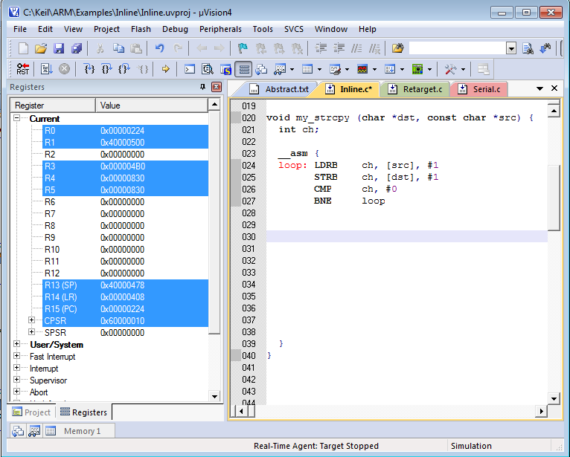
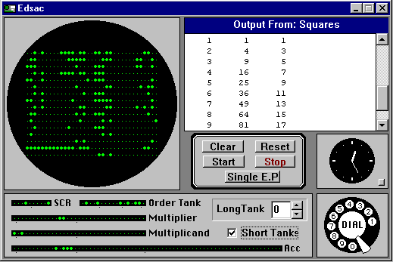
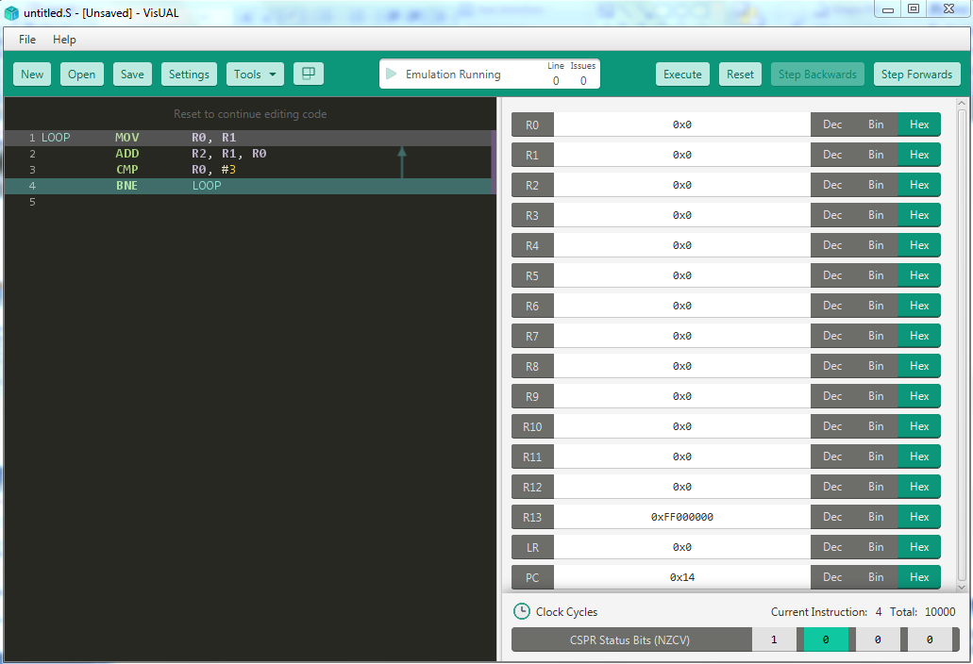
PART 2 - ARM Assembly Language
Keil ARM emulator & debugger
EDSAC simulator (Written by Martin Campbell-Kelly, Univ Warwick) – reproduces original EDSAC control panel.
EDSAC was the first computer to be programmed in an “assembly language”.
The assembler was 41 instructions long!
VisUAL
Notes:
For low-level programming you use an assembler and, usually a simulator as well as access to target hardware onto which programs can be loaded and run
Simulator is substitute for real hardware, can make debugging easier but does not handle all I/O correctly and is typically 10,000 X slower.

Slide 2
Part 2 - Contents
Lecture 5 & 6 - ARM data processing
ARM data processing instructions in detail
ARM shift unit and “flexible” op2
ARM condition codes and tests – conditional execution
ARM shifts and rotates
Real number representations
Lecture 7 – ARM Memory access
Addressing modes for LDR/STR
Memory pointers
Assembler pseudo-instructions
Lecture 8 & 9 – Subroutines, return addresses, and stacks
Why use subroutines?
Why use stacks?
Implementing stacks on ARM
ARM Multiple register transfer instructions
Miscellaneous
Hardware timing
multiply instructions

Slide 3
Lectures 5 & 6 – Data Processing
“and then the different branches of Arithmetic: Ambition, Distraction, Uglification, and Derision” The Mock Turtle – Lewis Carrol
ARM ALU operations are 3 (register) operand 32 bit
All ARM ALU operations use “flexible op2”
Register
Numeric literal
Shifted/rotated register
ARM ALU operations include two special cases where one of the registers is not used:
MOV,MVN (op1 not used)
CMP, TST, TEQ, CMN comparison instructions (destination not used)
Notes:
This lecture: how to do arithmetic on ARM

Slide 4
ARM data processing instruction op-codes
Op Assembly Operation Pseudocode
0000 AND Rd,Rn,op2 Bitwise logical AND Rd := Rn AND op2
0001 EOR Rd,Rn,op2 Bitwise logical XOR Rd := Rn XOR op2
0010 SUB Rd, Rn, op2 Subtract Rd := Rn – op2
0011 RSB Rd, Rn, op2 Reverse subtract Rd := op2 – Rn
0100 ADD Rd,Rn,op2 Add Rd := Rn + op2
0101 ADC Rd,Rn,op2 Add with carry Rd := Rn + op2 + C
0110 SBC Rd, Rn, op2 Subtract with carry Rd := Rn op2 + C – 1
0111 RSC Rd, Rn, op2 Reverse sub with carry Rd := op2 – Rn + C – 1
1100 ORR Rd,Rn,op2 Bitwise logical OR Rd := Rn OR op2
1101 MOV Rd, op2 Move Rd := op2
1110 BIC Rd,Rn,op2 Bitwise clear Rd := Rn AND NOT op2
1111 MVN Rd,op2 Bitwise move negated Rd := NOT op2
The operations with Carry allow multi-word addition and subtraction
MOV, MVN do not use Rn, (Rn should be set to 0 in instruction word)
Notes:
Red – logical
Green – arithmetic
Black – move
NB compare instructions (CMP, TEQ,TST) not shown

Slide 5
Reference - Comparison instructions
Op2 is “flexible op2”
Destination register is not used
Instruction | Sets condition codes AKA status flags identically to: | Typical Use
CMP op1, op2 | SUBS Rd, op1, op2 | arithmetic comparison
CMN op1, op2 | ADDS Rd, op1, op2 | arithmetic comparison with negative literal – generated automatically
TST op1, op2 | ANDS Rd, op1, op2 | test individual bit field using numeric literal mask
TEQ op1, op2 | EORS Rd, op1, op2 | test bit equality
Notes:
These instructions are different machine code from the equivalents because they DON’T SET RESULT REGISTER. This saves one register if only a test is needed.

Slide 6
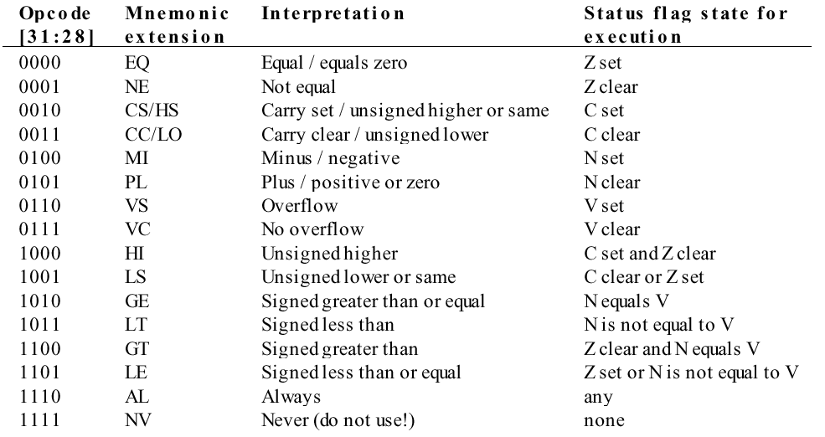
Reference - ARM condition code field
Instruction execution controlled by condition codes: N,Z,C,V
BMI LABEL ; Branch to LABEL on MI condition
Notes:
For reference

Slide 7
Data processing machine word format
immediate
value
op1 dest op2
4 1 1 1 4 1 4 4 4 8
cond
0
0
1
Op
S
Rn
Rd
Rot
K
Rd := Rn Op K
0
Shift
Rm
Rd := Rn Op Rm
ALU operation
8 4
S bit = 1 => NZ are written, CV are written for arithmetic
S bit = 0 => NZCV unchanged
(exception, CMP condition codes arealways changed)
The first operand, op1, is always register Rn
The second operand, op2, is either a constant K or register Rm
This lecture: assume Shift=0, Rot=0, for unshifted Rm or immediate constant K
dest := op1 op op2
Notes:
This slide shows exactly how all data processing instructions are packed into 32 bit word
Takes up 25% of all possible bit combinations!
Note two different forms have different op2 controlled by bit 25
Rd is dest, Rn is op1, Rm or K is op2
Note op-code is 00 + ALU operation field.
Rest of bits are operands are other instruction modifiers

Slide 8
Example - instruction in 32 bits
op2 = Rm
cond
0
0
0
Op
S
Rn
Rd
Shift
Rm
Rd := Rn Op Rm
1110
0
0
0
0100
0
0001
0000
0000,0000
0010
R0 := R1 + R2
n
d
m
Op = 0100 (ADD)
Cond = 1110 (always)
Rd = 0 R0
Rn = 1 R1
Rm = Op2 = 2 R2
S = 0 (don't write condition codes)
ADD R0, R1, R2
Is translated by the assembler into this instruction word
Notes:
Op2 is register so bit 25 is 0
S field = 0 because there is no S appended to op-code. So NZCV are not updated from result
For now assume cond field is 1110 – normal value

Slide 9
Data Processing Instructions (1) Arithmetic with/without CARRY
ADD R0, R1, R2 ; R0 := R1 + R2
SUB R0, R1, R2 ; R0 := R1 - R2
ADC R0, R1, R2 ; R0 := R1 + R2 + C
SBC R0, R1, R2 ; R0 := R1 - R2 + (C - 1)
Operands & result may be interpreted as unsigned or 2's complement signed integers.
'C' is the carry (C) flag in the CPSR
 | C = 0 | C = 1
ADC | normal | +1 carry in
SBC | -1 borrow in | normal
Notes:
Note difference between C forms and normal forms
Note different use of Cin for ADD SUB

Slide 10
S suffix to op-code and S bit in machine word
Data processing op-codes with S suffix will write condition codes
arithmetic (ADD, SUB etc) writes NZCV
all others (logical, move) write NZ
Data processing Mnemonics without S do not change condition codes.
C holds its previous value except when written by ADDS etc
SUBS R10, R10, #1 ; decrements R10 & tests its value
Assembler | Condition codes written
ADDS,SUBS,ADCS,SBCS, RSBS, RSCS | NZCV
ANDS, MOVS, all others | NZ
CMP (identical to SUBS except no dest-op) | NZCV
MOV R0, #7 ; "loop counter"
LOOP ; execute loop 7 times
....; do something
SUBS R0, R0, #1 ;V=0, Z=0/1, N=0, C=1
BNE LOOP ; branches if Z=0
Notes:
Add S to any data processing op-code to write flags
Write CV only if arithmetic
In example SUBS performs two functions: it decrements loop counter and sets NZCV on result. Only Z is used by BNE instruction
CMP special case also writes NZCV

Slide 11
64 bit addition
ADCS
ADDS
"Long addition" uses multiple 32 bit words with C (carry) condition code providing link from LSW to MSW
In this example 2 pairs of registers (64 bit numbers) are added to make a 64 bit result in a third pair of registers
Why are R0,R2 added with ADDS & R1,R3 added with ADCS?
What will C be at end?
63 R1 32
31 R0 0
63 R3 32
C
31 R2 0
+
63 R5 32
31 R4 0
MSW
Most Significant Word
CARRY
LSW
Least Significant Word
R5:R4 := R1:R0 + R3:R2
ADDS R4, R2, R0
ADCS R5, R3, R1
Notes:
Each 64 bit number stored in two registers: eg result is R5:R4 (R5 is MSW)
C is used for carry between Least significant word (LSW) and Lost significant word (MSW)
Therefore first ADD must be ADDS to set C
Second add must be ADC to use C
Add S to second ADD to store overall Carry for later use if needed

Slide 12
How does C change through 64 bit addition?
R1:0 = 0x00000000,00000001
R3:2 = 0xFFFFFFFF,FFFFFFFF
R5:4 = 0x00000000,00000000
 | adder cin | adder cout | R4 | R5 | C | C in general case just after instruction
initially | n/a | n/a | ? | ? | ? | ?
ADDS R4, R2, R0 | 0 (=0) | 1 | 0 | ? | 1 | result of LSW add
ADCS R5, R3, R1 | 1 (=C) | 1 | 0 | 0 | 1 | result of MSW add – unsigned oveflow
Notes:
This slide shows how C flag relates to carry out and carry in of ALU adder during addition
Note how C changes during a multi-word addition
Initial value here does not matter
LSW – least significant word (R0, R2, R4)
MSW – most significant word (R1, R3, R5)

Slide 13
Example: 'Multiple word add without ADC'
Here is how would we implement multi-word addition without ADC or equivalent. Not real code!
If R2+R0 addition gives C=1 add extra 1 to R3
If addition of 1 to R3 gives C=1 do R3+R1 addition without setting carry (because we know carry must be 1)
Otherwise do R3+R1 setting C from result
Does C at the end of this computation have the correct value (1 if the 64 bit unsigned addition overflows)?
BCC - Branch on Carry Clear
BCS - Branch on Carry Set
R5:4 := R3:2 + R1:0
How to analyse this code?
ADDS R4, R2, R0
BCC ADD_MSW_SETC
ADDS R3, R3, #1
BCC ADD_MSW_SETC
ADD R5, R3, R1
B ENDADD
ADD_MSW_SETC
ADDS R5, R3, R1
ENDADD ; finished when we get here
Notes:
This example shows why ADC is important!
We could use a branch instruction to test whether C is 1 from LSW and if so add 1 to MSW
Trouble is that carry from MSW could occur either from addition of two registers or from addition of C (if this is needed)
We must check:
First branch happens if simple case no carry
Second branch happens if if there is no carry from the +1 and therefore the final carry should come from MSW addition as normal
Third branch skips the carry-setting MSW addition
Therefore C is correct at end of computation

Slide 14
Case analysis: path through code
Path depends on whether least significant word addition has carry, and on whether adding the carry (1) onto the most significant word (MSW) generates a carry
ADDS R4,R2, R0 | Carry out = 0 | Carry out = 1 | Carry out = 1
ADDS R3, R3, #1 | n/a | Carry out = 0 | Carry out = 1
1
2
ADDS R4, R2, R0
BCC ADD_MSW_SETC
ADDS R3, R3, #1
BCC ADD_MSW_SETC
ADD R5, R3, R1
B ENDADD
ADD_MSW_SETC
ADDS R5, R3, R1
ENDADD
ADDS R4, R2, R0
BCC ADD_MSW_SETC
ADDS R3, R3, #1
BCC ADD_MSW_SETC
ADD R5, R3, R1
B ENDADD
ADD_MSW_SETC
ADDS R5, R3, R1
ENDADD
ADDS R4, R2, R0
BCC ADD_MSW_SETC
ADDS R3, R3, #1
BCC ADD_MSW_SETC
ADD R5, R3, R1
B ENDADD
ADD_MSW_SETC
ADDS R5, R3, R1
ENDADD
1
1
1
2
2
3
3
3
This code is so horrible all known ISAs have ADC or equivalent!

Slide 15
Example – 96 bit addition
Y:
95 R5 64
63 R4 32
31 R3 0
X:
95 R2 64
63 R1 32
31 R0 0
Let’s add two 96-bit numbers X and Y, storing the result back in X. This reduces the number of registers needed.
We need three registers to hold each number - registers are 32 bit
Store X as R2:R1:R0, Y as R5:R4:R3
Notation: R2:R1:R0 ≡ R2 = X(95:64), R1 = X(63:32), R0 = X(31:0)
Then:
“S” at the end of an instruction means you want to write the C, V, N, and Z flags. In this case only the C flag is used.
Similarly, if we wanted to subtract the two numbers (X-Y):
ADDS R0, R0, R3 ; R0:=R0+R3 (write C) ADCS R1, R1, R4 ; R1 := R1+R4 +C (write C)
ADCS R2, R2, R5 ; R2 := R2 + R5 + C (write C)
SUBS R0, R0, R3 ; without carry SBCS R1, R1, R4 ; with carry
SBCS R2, R2, R5 ; with carry
Notes:
Now back to adding the way it should be done!
This is like 64 bit addition but one more register
To reduce total number of registers we reuse one operand as result.
Note that SBCS does the right thing for 64 bit subtraction (C is then a “borrow” if 0)
Good example of why lots of registers are needed!
Note typo in red on printed notes

Slide 16
Data Processing Instructions (3) - Logical Register Operations
Op Assembly Operation Pseudocode
0000 AND Rd,Rn,op2 Bitwise logical AND Rd := Rn AND op2
0001 EOR Rd,Rn,op2 Bitwise logical XOR Rd := Rn XOR op2
1100 ORR Rd,Rn,op2 Bitwise logical OR Rd := Rn OR op2
1110 BIC Rd,Rn,op2 Bitwise clear Rd := Rn AND NOT op2
assembler | R1=0000 0000 0000 0000 1111 1111 0000 0000 R0=0000 0000 0000 0000 1010 1010 1010 1010 | Boolean op
AND R2, R1, R0 | R2=0000 0000 0000 0000 1010 1010 0000 0000 | and
EOR R2, R1, R0 | R2=0000 0000 0000 0000 0101 0101 1010 1010 | xor
ORR R2, R1, R0 | R2=0000 0000 0000 0000 1111 1111 1010 1010 | or
BIC R2, R1, R0 | R2=0000 0000 0000 0000 0101 0101 0000 0000 | bit clear
"Bitwise logical" each bit of result is calculated from op applied to the same bit in the two operands
Notes:
Understand what “bitwise operation” means!
An AND with one input inverted is a “bit clear” operation BIC. Useful.

Slide 17
Negative numeric literal values?
Since literal op2 = K is an unsigned value it cannot be used directly to set a register to a negative number
However usually this does not matter, because a different op-code can be used, giving equivalent function with a positive literal op2:
The assembler will do this conversion automatically
See next slides
Assembler written by programmer | Actual machine code equivalent
ADD R0, R1, #-11 | SUB R0, R1, #11
SUB R0, R1, #-100 | ADD R0, R1, #100
Notes:
Hash introduces K value (number) for immediate op2
Negative K values don’t exist as machine code! But they can be fabricated from different instructions with positive K values
Assembler automatically translates

Slide 18
Example
4 1 1 1 4 1 4 4 4 8
cond
0
0
1
Op
S
Rn
Rd
Rot
K
Rd := Rn Op K
1110 001 0110 1 0100 0001 0000 00000011
always SBC Rn=R4 Rd=R1 K= #3
use K form
write flags N,Z,C,V
R1 := R4 -4+C | ADCS R1, R4, #-4 SBCS R1, R4, #3 | The ADCS is turned into equivalent SBCS automatically Why #3 not #4?
Notes:
SBCS gives answer 1 smaller than ADCS because the carry is -1,0 not 0,1
So we need to subtract 1 less
This “error” is peculiar to the way C is used differently in ADC and SBC. It does not apply to ADD,SUB

Slide 19
ADC R0, R1, #n; R0 := R1 + n + C ; C is carry
SBC R0, R1, #n; R0 := R1 - n + (C -1) ; (C-1) is borrow
SBC R0, R1, #n; R0 := R1 - n ; if C = 1 (no borrow)
SBC R0, R1, #n; R0 := R1 - n -1 ; if C = 0 (borrow)
The difference in polarity of C due to borrow means the literal must be changed when transforming from ADC to SBC or vice versa.
This issue only exists for ADC, SBC, RSC, since these use C as input and so differ by 1 when negated
Assembler | Translates to
ADC Ra, Rb, #-n | SBC Ra, Rb, #(n-1)
SBC Ra, Rb, #-n | ADC Ra, Rb, #(n-1)
Notes:
This is true for all three “C” instructions: ADC, SBC, RSC

Slide 20
Reference - ARM condition code field
Instruction execution controlled by condition codes: N,Z,C,V
Notes:
For reference

Slide 21
The ARM has a clever way of implementing conditional branches.
All instructions are given an execution condition calculated from values of condition codes which determines whether they are executed, or ignored. If an instruction is ignored it has no effect on registers.
Condition is the top 4 bits of instruction machine word, shown in assembler as two letter suffix to op-code (previous slide).
The “always true” condition (1110) is used with most instructions to make execution unconditional
A single branch instruction (B) provides conditional and unconditional branches because of its execution condition:
B BEQ BNE BVS BCS BLO (see previous slide)
Other non-branch instructions can be conditionally executed, giving new ways to express algorithms.
Notes:
All ARM instructions are conditionally executed
Condition true => instruction executes normally
Condition false => no change to processor state – instruction skipped

Slide 22
Comparison Data processing instructions
Compare instructions have source operands op1, op2 and format identical to data processing but they have no destination register and they always set flags (no S needed).
CMP is most used but others can be useful.
Every compare instruction operates identically to a normal data processing instruction with “S” bit as shown except that nothing is written to a destination register
Instruction | sets flags as | Use
CMP op1, op2 | SUBS Rd, op1, op2 | arithmetic comparison
CMN op1, op2 | ADDS Rd, op1, op2 | arithmetic comparison with negative literal (see slide 2.19)
TST op1, op2 | ANDS Rd, op1, op2 | test individual bit field using mask
TEQ op1, op2 | EORS Rd, op1, op2 | test bit equality
Notes:
These instructions are different machine code from the equivalents because they DON’T SET RESULT REGISTER. This saves one register if only a test is needed.

Slide 23
Tricks with "S"
Branch with condition after data processing instruction
Branch with condition after comparison
MOV R0, #10
LOOP ADD R1, R1, R2
SUBS R0, R0, #1 ; set codes
BNE LOOP ; branch on codes
MOV R0, #10
LOOP ADD R1, R1, R2
SUB R0, R0, #1
CMP R0, #0 ; set codes
BNE LOOP ; branch on codes
; Note S instruction need not be immediately before BNE instruction
MOV R0, #10
LOOP SUBS R0, R0, #1 ; set codes
ADD R1, R1, R2 ; all other instructions preserve codes
BNE LOOP ; branch on codes
Notes:
Here is how we use conditional executed branch instructions
Note three different styles all possible, do the same thing in this example

Slide 24
Shifts and Rotates in the ARM ISA
“The best teachers have shown me that things have to be done bit by bit. Nothing that means anything happens quickly – we only think it does”, Joseph Bruchac
Individual bits can have separate meanings in assembly programs
Hardware registers where every bit is a separate flag
Hardware registers where bit fields have specific meaning
Two types of operation help manipulating bits
32 bit bitwise logical data processing instructions:
AND, ORR, EOR, BIC.
Shifts & rotates
Shifts are also used in arithmetic

Slide 25
Register Shifts in ARM data processing
ADD R0, R1, R2, LSL #3
MOV R0, R1, LSR #11
op2 shifted
Data Shift: op2 has each bit displaced a fixed number of places right or left.
shifts can be combined with arithmetic or bitwise logical operations in one instruction.
Rd := Rn op (Rm shift by N) ;
shift = LSL, LSR, ASL, ASR, ROR, RRX
0 ≤ N ≤ 31
RRX is special case only possible by 1 bit (N=1).
NOTE shifted value is used for op2 with no change to Rm
Registers
Rn
Rm
K
MUX
SHIFT
N
op1
op2
ALU
Notes:
Note the shift specification in instruction looks like 4th operand
Number of bits shifted has range 0 – 31.

Slide 26
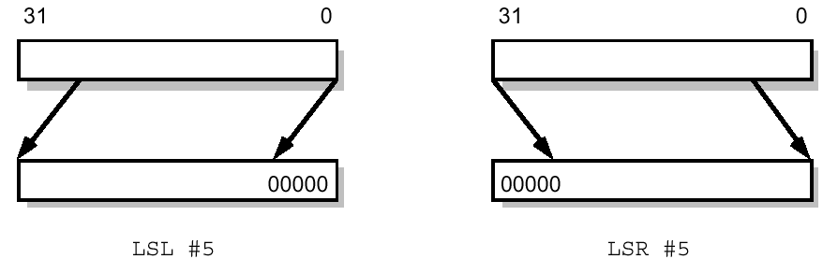
ARM shift operations - LSL and LSR
LSL: logical shift left by 0 to 31 places; fill the vacated bits at the least significant end of the word with zeros.
x LSL n = x*2^{n} if no overflow
MOV R1, R0, LSL #N →R1(m) := R0(m-N) or 0 if m-N < 0
LSR: logical shift right by 0 to 31 places; fill the vacated bits at the most significant end of the word with zeros.
x LSR n = x/2^{n} if x is positive (integer division)
MOV R1, R0, LSR #N →R1(m) := R0(m+N) or 0 if m+N > 31
Notes:
LSL. Logical Shift Left. Shift by N bits same as multiply by 2**N
LSR. Logical Shift Right. Shift by N same as unsigned integer division by 2**N discarding remainder
Note that where in range bits are “shifted” N. Empty positions have 0 shifted in.

Slide 27
Examples
31 | 30 | 29 | 28 | 27 | 26 | 25 | 24 | 23 | 22 | 21 | 20 | 19 | 18 | 17 | 16 | 15 | 14 | 13 | 12 | 11 | 10 | 9 | 8 | 7 | 6 | 5 | 4 | 3 | 2 | 1 | 0
 |  |  |  |  |  | 1 | 0 | 1 | 1 | 0
Extract R0(25:21) as an unsigned number, put this into R1(4:0)
Method 1: LSR followed by AND with constant 5 bit mask
Method 2 LSL followed by LSR
When does method 1 not work for this type of problem?
METHOD1
MOV R1, R0, LSR #21
AND R1, R1, #0X1F
METHOD2
MOV R1, R0, LSL #6
MOV R1, R1, LSR #27
Notes:
Method 1 does not work when the “mask” 0x1F here is too big to be an immediate constant in a data processing instruction.

Slide 28
ARM Trick: Multiplying by a (small) constant using LSL
Multiplying by 2^{N} is easy using a left shift. Other constants can be derived from this by using ADD or RSB as in the table below.
2,3,4,5,7,8,9, etc are all possible in this way
Where possible it is better than using a MUL instruction because it is faster, and uses immediate values directly from instruction words (don't need to set register to N)
R0 := 2^{N}R1 | MOV R0, R1, lsl #N
R0 := (2^{N}+1)R1 | ADD R0, R1, R1, lsl #N
R0 := (2^{N}-1)R1 | RSB R0, R1, R1, lsl #N | Note RSB not SUB
ADD R0, R0, R0, lsl #2
RSB R0, R0, R0, lsl #3
What does this multiply by?
Notes:
As in example here can multiply by larger numbers which factorise into 2**N+1, 2**N, or 2**N-1 form factors
Here 35 is (4+1)(8-1)

Slide 29
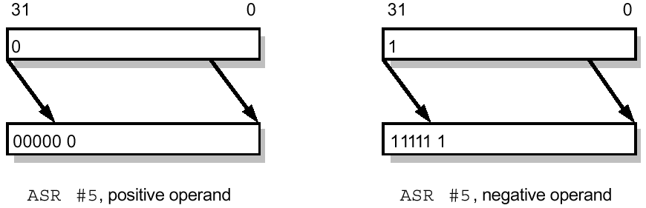
ARM shift ops - ASL and ASR
x | x ASR 1
3 | 1
2 | 1
1 | 0
0 | 0
-1 | -1
-2 | -1
-3 | -2
-4 | -2
ASL: arithmetic shift left; this is the same as LSL
ASR: arithmetic shift right by 0 to 31 places; fill the vacated bits at MS end of the word with zeros if the source operand was positive, and with ones it is negative. That is, preserve sign while shifting right.
x ASR n = x / 2^{n} (x>0)
-x ASR n = -(x+1) / 2^{n} = -x/2^{n} (rounding negatively)
MOV R1, R0, ASR #N → R1(m) := R0(m+N) if m+N ≤ 31
or R0(31) if m+N > 31
How do you use ASR in method 2 of slide 2.27 for a signed 5 bit field?
Notes:
Like LSL,LSR, but works for signed data
ASL is identical to LSL
ASR preserves the sign bit
Be careful of how the rounding is done – it is always downwards in direction as shown

Slide 30
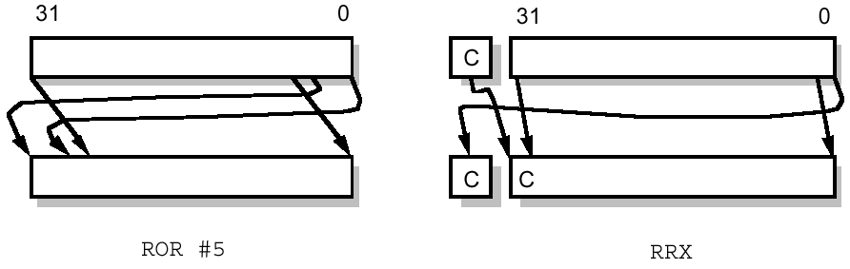
ARM rotate operations - ROR and RRX
ROR: rotate right by 0 to 31 places; the bits which fall off the least significant end are used to fill the vacated bits at the most significant end of the word.
MOV R1, R0, ROR #N →
R1(m) := R0( (m+N) mod 32) ; NB mod is like remainder
RRX: rotate right extended by 1 place; the vacated bit (bit 31) is filled with the old value of the C flag and the operand is shifted one place to the right. This is effectively a 33 bit rotate using the register and the C flag.
MOV R1, R0, RRX →
R1(m) := R0(m+1)
R1(31) := C
C := R0(0) ; NB only is S is used see 2.33
ROR: Why it's called rotate!
MSB LSB
RRX: Why it's called rotate!
C
MSB LSB
C changed only if S=1
Notes:
ROR is easy – like shift but nothing is lost – bits shifted out are immediately shifted in the other end
RRX is special case shift only by 1. Uses carry so can do multi-word shifts

Slide 31
Immediate op2
ADD R0, R1, #0x204
MOV R0, #0x4C00
MOV R2, #0xC0000001
ADD R0, R1, #0x81, ROR #30
MOV R0, #0x4C, ROR #24
MOV R2, #7, ROR #2
Registers
A right rotate of 2R is applied to any K value in range 0-255 where R = 0, 1,...15 comes from the instruction (equivalent to left rotate of 32-2R)
Immediate operands can be any number of up to 7 bits, placed anywhere in a 32 bit word, or up to 8 bits placed with LSB on even bit number
Rn
Rm
K
MUX
Rotate
N
op1
op2
0000,0000,1101,0010,0000,0000,0000,0000
ALU
N = 2R from Instruction
0x69 * 2¹⁷ = 0xD2 * 2¹⁶ K=0xD2, R=24
Notes:
We can rotate any 8 bit or less operand by any even number of bits.
A 7 bit operand can always be offset by 1 bit so effectively positioned anywhere within word.
Conversion of large immediate values into smaller ones with rotate is done automatically where possible

Slide 32
Shift by number of bits equal to value of a register
ADD R0, R1, R2, LSL R3 ; shift R2 by value of register R3 and add!
MOV R0, R1, ASR R10 ; shift R1 by value of register R10
The number (N previously) of bits to shift is now the value of another register.
Note that one extra operand is needed!
MOV R0, R1, LSL R3
If R3 = 4 & R1 = 11 this will set
R0 := 11*2⁴
This allows variable shifts, eg, to select bit B from a 32 bit register
NB in most ARM architectures this instruction is SLOW – see later!
Notes:
Syntax for this now has 4 registers!
Instructions of this form take 2 cycles

Slide 33
The Carry flag and shifts/rotates
Carry flag is written when condition codes are written and there is a meaningful Carry
Carry out from ADD/ADC/SUB/SBC/RSB/RSC/CMP/CMN
Carry from shift or rotate as below
Carry from arithmetic takes precedence over Carry from shift/rotate when both are meaningful.
Carry from shift/rotate is the last bit shifted out of Rm
In the case of a ROR ‘last bit shifted out' is defined to be the last bit shifted off LSB and into MSB of the register,
Arithmetic instructions which write C anyway (ADDS, CMP, etc) can be used with shifts for op2
In this case C is specified by the arithmetic operation, not the shift.
Notes:
When is C written by shift or rotate?
C is not written by arithmetic
S is set in the instruction

Slide 34
Example1a: reversing bits in a register
R0
This method is obvious, but very inefficient
Use register valued shifts to extract and set each bit in turn
R1
Distance moved is determined by R2
R0
R1
AND
OR
R2 = B
R3 1
shift by B bits
1 R4
REVERSE MOV R2, #0 ; B: count of number of bits
MOV R1, #0 ; register to accumulate result
MOV R3, #1 ; constant with bit 0 set to 1
MOV R4, #0x80000000 ;constant with bit 31 set to 1
LOOP
ANDS R5, R0, R3, LSL R2 ;Z=0 iff bit B of R0 is 1
ORRNE R1, R1, R4 LSR R2; ;if Z=0 Set bit 31-B in R1 to be 1
ADD R2, R2, #1
CMP R2, #32 ; if more, go back to loop
BNE LOOP ; if R2 ≠ 32
Notes:
“Bit reversal” R1(n) := R0(31-n) where R0(a) means the ath bit of R0 etc
Why is the MOV with N = 0x80000000 OK?
Bit N is extracted from R0 using AND op and 1 shifted left (LSL) by B (R2) from bit 0
Bit 31-N is added into R1 if previous bit was non-zero by using 1 shifted right (LSR) by B from bit 31
Loop repeats for B = 0 – 31, stop when B = 32.

Slide 35
Example 1b: reversing bits
Note in previous example need to use CMP/ADD/BNE and R2 ranges from 0 to 31 inside the loop.
If R2 ranged from 32 down to 1 in loop we could use SUBS /BNE
If R2 ranged from 31 down to 0 in loop we could use SUBS/BPL
R5 is not used. TST (similar to CMP) allows AND to set condition codes without needing a destination register
REVERSE MOV R2, #31 ; B: count of number of bits
MOV R1, #0 ; register to accumulate result
MOV R3, #1 ; constant with bit 0 set to 1
MOV R4, #0x80000000 ;constant with bit 31 set to 1
LOOP
TST R0, R4, LSR R2 ;Z=0 iff bit (31-B) of R0 is 1
ORRNE R1, R1, R3 LSL R2; ;if Z=0 Set bit B in R1 to be 1
SUBS R2, R2, #1
BPL LOOP ; if R2 >= 0
Notes:
Improve looping using SUBS

Slide 36

Example 1c: reversing bits
To detect whether bit 31-B of R0 is 1 we do not need to use AND with a shifted 0x80000000.
We can shift R0 B bits left and check whether the MSB is 1.
Conveniently - this is the N condition code!
NB R5 is not used (but needed by MOVS)
R0
N
REVERSE MOV R2, #31 ; B: count of number of bits
MOV R1, #0 ; register to accumulate result
MOV R3, #1 ; constant with bit 0 set to 1
LOOP
MOVS R5, R0, LSL R2 ;N=1 iff bit 31-B of R0 is 1
ORRMI R1, R1, R3 LSL R2; ;if N=1 Set bit B in R1 to be 1
SUBS R2, R2, #1
BPL LOOP ; if R2 >= 0
Notes:
Use N condition code and MOVS instead of ANDS
Condition for 1 is now “MI”
R5 is written by the MOVS but never used. There is no simple way to use a compare instruction here because they all include op1 as well.
We can use R3 for op1, since R3 = 1 constant. This can be used only with TEQ in which case the N flag will be set the same way as MOVS
TEQ R3, R0, LSL R2
This saves one register

Slide 37
Example 2a: reversing bits
Instead of detecting and setting each bit individually we could shift each bit out of R0 MSB first, and shift back into R1, also MSB first.
Why do we need to use RRX?
R0
C
R1
REVERSE MOV R2, #31 ; B: count of number of bits
LOOP
MOVS R0, R0, LSL #1 ;shift bit out of R0 into carry
MOV R1, R1, RRX ;shift bit back into R1
SUBS R2, R2, #1
BPL LOOP ; if R2 >= 0
Notes:
Neat way to reverse bits!
Why is MOVS needed?
Can you see why it works?
Consider the first bit shifted out of R0 and into R1 – the MSB R0
After all shifts it will be the LSB of R1
Etc
Note NOT rrx #1

Slide 38
Example 2b: reversing bits with loop unrolling
The loop is executed exactly 32 times. We could copy the two shift instructions 31 times and so not need the BPL or SUBS instructions, nor the register R2
REVERSE
MOVS R0, R0, LSL #1 ; Original
MOV R1, R1, RRX
MOVS R0, R0, LSL #1 ;1st copy
MOV R1, R1, RRX
MOVS R0, R0, LSL #1 ;2nd copy
MOV R1, R1, RRX
; another 28 copies
MOVS R0, R0, LSL #1 ;31st copy
MOV R1, R1, RRX
R0
C
R1
Notes:
This uses more instructions – but is much faster!
The loop control instructions are not needed.
Note NOT rrx #1 (rrx is always by 1 and #1 is error for assembler)

Slide 39
An If-Then-Else example
Consider the pseudo-code:
If (a = 1) then c := c+1 else d := d-1
Needs to be implemented using conditional branches, or, as we will see, conditional execution.
First step is to assign registers to variables. We assume: a=R0, c=R2, d=r3, and then the problem becomes:
if (R0 = 1) then R2 := R2+1 else R3 := r3-1
To translate this pseudocode we need to use conditional branches or conditional execution
See next two slides

Slide 40
ITE – with conditional branches
Then part
Else part
if (R0 = 1) then R2 := R2+1 else R3 := r3-1
EXAMPLE
CMP R0,#1
BEQ THENPART
; else part
SUB R3, R3, #1
B ENDCODE
THENPART ; then part
ADD R2, R2, #1
ENDCODE
comparison
conditional
branch
Notes:
This code is classic in assembly language. Note how many branches are needed! The extra branch is used to jump over the THEN code when the ELSE code is executed.
PLEASE NOTE – arrows offset incorrectly on printed notes!

Slide 41
ITE - with conditional execution
We have seen that IF-THEN-ELSE constructions in pseudo-code turn into multiple branches in assembly.
If the THEN and ELSE statements are short, branches can be avoided by using conditional execution.
Note: NE condition is opposite of EQ condition
Adding an execution condition to any ARM instruction makes its execution conditional
CMP R0, #1
BEQ THENPART
SUB R3, R3, #1 ; else part
B ENDCODE ; go to end
THENPART
ADD R2, R2, #1 ; then part
ENDCODE ; finished
CMP R0, #1
SUBNE R3, R3, #1 ; else part
ADDEQ R2, R2, #1 ; then part
; finished
Notes:
In the optimised version control moves through the three instructions. The SUB and ADD are both controlled by the Z flad set by CMP and not subsequenctly changed.
It turns out this optimisation saves time and instructions, because B instructions take much more time than data processing instructions. See later.

Slide 42
Example: Revisiting 'Multiword Add without ADC'
ADDS R4, R2, R0
BCC ADD_MSW_SETC
ADDS R3, R3, #1
BCC ADD_MSW_SETC
ADD R5, R3, R1
B ENDADD
ADD_MSW_SETC
ADDS R5, R3, R1
ENDADD ; finished
ADDS R4, R2, R0
BCC ADD_MSW_SETC
ADDS R3, R3, #1
BCC ADD_MSW_SETC
ADD R5, R3, R1
B ENDADD
ADD_MSW_SETC
ADDS R5, R3, R1
ENDADD
ADDS R4, R2, R0
ADDSCS R3, R3, #1
ADD R5, R3, R1
ADDSCC R5, R3, R1
ENDADD ; finished
ADDS R4, R2, R0
BCC ADD_MSW_SETC
ADDS R3, R3, #1
BCC ADD_MSW_SETC
ADD R5, R3, R1
B ENDADD
ADD_MSW_SETC
ADDS R5, R3, R1
ENDADD
Efficiency measure | Old | New
Number of instructions | 7 | 4
Number of instructions executed | 3 or 5 or 6 | 4
Total execution time (depends on architecture and path through code) | 6 or 8 or 9 | 4
ADDS R4, R2, R0
BCC ADD_MSW_SETC
ADDS R3, R3, #1
BCC ADD_MSW_SETC
ADD R5, R3, R1
B ENDADD
ADD_MSW_SETC
ADDS R5, R3, R1
ENDADD
Notes:
The horrible ADC code can be simplified using this technique!
ADDCS – execute if C = 1
ADDCSS execute if C = 1, if executed set C on result carry
Note that execution time is not the same as number of instructions executed
Note that executed instructions – if condition is false – may not actually happen – we need some new language to distinguish the two cases of:
Executed (in stream of instruction execution, but condition is false so nothing happens) – condition false executed
Executed (actually happens because also condition is true) – condition true executed
More later

Slide 43
Arithmetic on real numbers
So far, we have concentrated on integer representations – signed or unsigned.
There is an implicit binary point to the right:
In general, the binary point can be in the middle of the word (or off the end!). This is a FIXED POINT representation of real numbers
Fixed point arithmetic requires no extra hardware – the binary point is in the mind of the programmer, like signed/unsigned the CPU does not care!
What is the resolution of the two fixed point schemes above?
00001101.
not stored
0000110100000.
0011.0101
binary points
Notes:
How to represent and operate on real (fractional) numbers?
With n bits to right of binary point the resolution is 2^-n

Slide 44
Idea of floating point representation
Although fixed point representation can cope with numbers with fractions, the range of values that can represented is still limited.
Alternative: use the equivalent of “scientific notation”, but in binary:
number = s x m x 2e
For example:
Thus by choosing the correct exponent any number can be represented as a fixed point binary number in range 1.0000 - 1.1111 multiplied by an exponent which is a positive or negative power of 2.
Equivalently, the binary point is "floating"
sign
mantissa
exponent
10.5 decimal in binary: 1010.1₍₂₎
Move binary point 3 places to left: 1.0101₍₂₎ x 2³
10.5 = 1.3125 x 8
Notes:
Floating point allows high resolution for small numbers, while also allowing very large numbers (at lower resolution).
Similar to scientific notation in decimal. Split number into exponent part and mantissa part.
In binary exponent is power of 2. Mantissa is between 1 and 2.
(cf decimal, exponent is power of 10, mantissa is between 1 and 10)

Slide 45
IEEE-754 standard floating point
32-bit single precision floating point:
Exp field is unsigned
MSB s is sign-bit: 1 => negative
Exponent (power of 2) = exp - 127
Note this gives exponent in range [-127,127], and special case exp = 255
The MSB of the mantissa is ALWAYS ‘1’, therefore it is not stored
mantissa = 1 + frac*2⁻²³ (mantissa = 1.frac):
Why not exponent
= 128?
Notes:
IEEE-754 is standard 32 bit floating point format
BE CAREFUL – IT IS TRICKY
Exp field must hold signed numbers but is NOT two’s complement. It is excess 127 representation
Frac filed IS NOT mantissa. The first bit of the mantissa is always 1 and so need not be included in frac. Allows 24 bit mantissa using only 23 bits
Sign field is different from sign of exponent! Negative numbers have sign bit = 1.

Slide 46
Special cases in IEEE-754 representation
exp | frac | meaning | notes
0 | 0 | +/- 0 | The smallest non-zero numbers are used to mean 0, otherwise there is no exact 0!
255 | 0 | +/- ∞ | The largest exponent is used for special cases
255 | ≠ 0 | NaN | not a number, used for 0/0 etc
Notes:
Shoe-horn some special numbers into extreme values of exp and frac.
These values over-ride the normal representation on previous slide.

Slide 47
IEEE-754 → Decimal
s
exp
fractional part of mantissa
1
1
0
0
0
0
0
0
0
1
1
0
0
0
0
0
0
0
0
0
0
0
0
0
0
0
0
0
0
0
0
0
-1
128
.11₍₂₎
The number above, C0600000₍₁₆₎ , must have negative sign,
(subtract 127) Exponent = exp -127 = 1,
(add 1.) mantissa = 1+ 0.11₍₂₎ = 1.11₍₂₎
- 2¹ X 1.11₍₂₎ = -11.1₍₂₎ = -3.5
Note 1.0 is always added to 0.frac to make a mantissa:
1.0 ≤ mantissa < 2
Notes:
This slide describes how to convert from IEEE 754 FP to decimal

Slide 48
Decimal → IEEE 754
17.5₍₁₀₎ = 35₍₁₀₎*2⁻¹ = 10001.1₍₂₎ = 2⁴ * 1.00011₍₂₎ ➔
(add 127) exp = 4+127 = 131 = 10000011₍₂₎
(extract bits to right of binary point) frac = 00011000000000000000000₍₂₎
s = 0 (positive)
0100 0001 1000 1100 0000 0000 0000 0000
4 1 8 C 0 0 0 0
Floating point translation is typically handled by Floating Point coprocessor (FPU) separate from but connected to the CPU. ARM architecture has FPUs, see latest ARM datasheets for more details.
We will not consider ARM FPU instructions in this course.
CPU
FPU
Memory
unit
Notes:
This slide shows how to convert decimal into floating point
Typically on a CPU a special FPU (floating point unit) will be used to do floating point operations.
If it is not present the same can be done with a subroutine of normal instructions, but that is a lot slower.
In this example the first step is to express the decimal number in standard form as a mantissa and exponent
The exponent is the number of places the binary point needs to be moved to go from original to mantissa in range 1-2

Slide 49
Part 2 Summary
Dataflow instructions, compare instructions, immediate operand 2
NZCV flags and S suffix
Example: multiword add without ADC
Execution conditions
Shifts and rotates
Efficient implementations of ITE (if then else) in ARM assembler.
IEEE 754 32 bit real representation
Data Processing & shifts
Data transfer
Subroutines

Slide 50
Lecture 7 - Data Transfer Instructions (Load/Store)
“Computer programmers don't byte, they nibble a bit” - Unknown
This lecture will examine in detail the ARM single register LOAD/STORE instructions
Multiple register load/store instructions will be dealt with separately, when we are discussing stacks.
The ARM architecture has
some clever tricks which mean that memory locations close to the PC can easily be accessed.
special support for sequential data access

Slide 51
Why use LOAD/STORE?
1. Calculations can be done quickly using registers, with no use of memory.
2. Calculations on memory locations require LOAD of input data to registers followed by STORE of results back to memory
3. Since number of registers is limited all practical programs need to use memory locations as well as registers
Exactly how intermediate results are transferred between registers and memory locations (register allocation) is interesting and an important research field in Computer Science
When programming in a high level language you don't care. The compiler will manage data, storing it in memory or registers as necessary. Clever optimising compilers will look at the whole program and optimise register allocation for most efficient execution
Not part of this course, but those interested could start by reading:
http://en.wikipedia.org/wiki/Register_allocation
Notes:
In principle operations could be done on memory data, or registers
TI designed an early microprocessor TI-990 series - clever but very slow - that did all calculations directly on memory workspaces
Approach doomed in the end, because registers are faster
But you need memory as well because the number of registers are limited
Hence LOAD & STORE

Slide 52
Memory review
Memory locations store instructions or data and each have unique numeric addresses
Usually addresses range from 0 up to some maximum value.
Memory space is the unique range of possible memory addresses in a computer system
We talk about “the address of a memory location”.
Each memory location stores a fixed number of bits of data, normally 8, 16, 32 or 64
We write mem₈[100], mem₁₆[100] to indicate the value of the 8 or 16 bits with memory address 100 etc. 0x indicates hex number.
mem₁₆[0x02E] = 0x0AA0
0x000
0x002E
0x001
0x202F
machine code
0x002
0x1030
0x003
0x7000
0x004
--
0x005
--
0x006
--
...
0x02E
0x0AA0
0x0110
data
0x02F
0x030
0x0BB0
Notes:
This is revision:
memory locations store instructions and data
each location has a unique numeric address
memory space if the set of all possible memory addresses
mem8[100], mem16[100]

Slide 53
Nibbles, Bytes, Words
Internal datapaths inside computers could be different width - for example 4-bit, 8-bit, 16-bit or 32-bit.
For example: ARM processor uses 32-bit internal datapath
WORD = 32-bit for ARM, 16-bit for MU0, 64 bit for latest x86 processors
BYTE (8 bits) and NIBBLE (4 bits) are architecture independent
Note bit numbers: 31 - most significant bit - MSB, 0 - least significant bit - LSB
31
24
23
16
15
8
7
0
MSB
LSB
Note MSB also means most significant byte!
Nibble
Byte
Word
Notes:
in ARM7 processor words are 32 bit
In general words have variable size
Nibles, bytes are fixed.

Slide 54
Byte and Word addressing
Many programs, for example those manipulating characters – each of which takes up one byte – need to access memory as an array of bytes, not words.
For example in a 16 bit system there are 2 bytes for every word. This means that byte addresses must increase twice as fast as word addresses. There are two different ways to number bytes within a word as below.
NB. Numbers in locations are byte address, not data
MSB
LSB
MSB
LSB
Little-endian
Big-endian
Endian-ness
0:
1:
0:
0:
1:
Word number
1:
3:
2:
2:
3:
2:
5:
4:
4:
5:
3:
7:
6:
6:
7:
4:
...
...
...
...
Notes:
So far we have only considered addresses for memory locations
One address per byte is useful allowing individual bytes to be accessed in memory
In 16 but system byte addresses must go up twice as fast as word numbers

Slide 55
Byte addresses for words
Most computer systems now use little-endian byte addressing, in which the least-significant byte has the lower address.
It is inconvenient to have completely separate byte and word addresses, so word addressing usually follows byte addressing.
The word address of a word is the byte address of its lowest numbered byte. This means that consecutive words have addresses separated by 2 (16 bit words) or 4 (32 bit words) etc.
Little-endian
32 bit memory with consecutive word addresses separated by 4 allows byte addressing and word addressing to coincide
MSB
LSB
0:
3:
2:
1:
0:
Word address
4:
7:
6:
5:
4:
8:
11:
10:
9:
8:
12:
15:
14:
13:
12:
16:
…
…
…
…
Notes:
Here is ARM addressing - 32 bit words
Word addresses are no longer contiguous!
Words addresses are for convenience set equal to lowest byte address within word
Byte addresses have two options for ordering within a word.
We will by default use little-endian

Slide 56
What is an "address"?
Conceptually, a memory location address is just a name, like A,B,C,D. The location value (stored data) changes when data is written, not the address.
Practically, because addresses are numbers, we can use this fact to advantage
Numeric addresses allow sequential data access
Sequence of instructions when CPU is executing
Sequence of data items - e.g. in an array
ARM uses addresses for 32 bit words: 0,4, 8,....
The range of valid addresses is determined by hardware but always includes 0.
Notes:
This lecture we will see how ARM uses the fact that addresses are both numbers and ways to identify memory locations

Slide 57
Different views of memory access: byte or word
NB this example uses 16 bit (2 byte) memory. ARM memory is always 32 bit (4 byte)
16 bit word
view of memory
(little-endian)
Byte view
of memory
Different instructions to allow either byte or word access to memory.
Word read or write operates on a whole word Mem₁₆ in memory
The memory address is the word address (even number)
Byte read or write is similar except that a single byte (half a word here) is read or written Mem₈.
0x802
0x800
0x00
0x803
0x802
0x801
0x800
0x00
0x10
0x10
0x02
0x02
0x03
0x03
16 bits
8 bits
Mem₁₆[0x800]= 0x0203₍₁₆₎ = 515
Mem₁₆[0x802]= 10₍₁₆₎ =16
Mem₈[0x800]= 3
Mem₈[0x801]= 2
Mem₈[0x802]= 10₍₁₆₎= 16
Mem₈[0x803]= 0
Notes:
With byte and word addressing one numeric address can have two different meanings!
Note mem16, mem8, etc indicating the number of bits accessed.
Here word addresses must be divisible by two. We do NOT allow word access that straddles word boundaries. (eg mem16[0x801])

Slide 58
CPU Registers & Memory (part-word transfers)
CPU registers (X below, R0-R15 on 32 bit ARM) are normally same length as memory word
Word READ (easy):
X := Mem₃₂[addr]
Word WRITE (easy):
Mem₃₂[addr] := X
Byte READ: 8 →32?
X := 000000 Mem₈[addr]
Byte WRITE: 32 → 8?
Mem₈[addr] := X(7:0) (bottom 8 bits of X)
32 bits
LS
X(7:0)
X
Memory
8 bits
32 bits
Notes:
Transferring data between bytes in memory and registers (of word length) always uses the least significant 8 bits of the register.
On READ from memory the remainder (most significant 24 bits for ARM) of the register is set to 0

Slide 59
ARM LOAD and STORE Instructions
Instruction specifies memory address, and destination/source register
LOAD => dest register
STORE => src register
So far you have seen these in examples with a single label which represents the address of a memory location
How this works will be explained later!
Addresses are just numbers, and we will now see how this can be used to advantage
Instruction | meaning
LDR R0, TABLE1 | R0 := mem₃₂[TABLE1]
STR R0, TABLE2 | mem₃₂[TABLE2] := R0
CPU
Memory Unit
Data Address
TABLE1
R0:
TABLE2
Notes:
Note the equivalent pseudocode
LDR/STR operate on 32 bit words
Here the numeric value of labels TABLE1, TABLE2 is the corresponding address

Slide 60
Register Addressing
Use the value in a register to make the memory address
Fast
Allows data to be placed anywhere in 32 bit memory space (4Gbytes)
IMPORTANT: which data values change in these two instructions?
Instruction | Meaning
LDR R0, [R1] | R0 := mem₃₂[R1]
STR R0, [R2] | mem₃₂[R2] := R0
CPU
Memory Unit
R1:
0x100
R2:
0x1800,0000
Data Address
0x100
R0:
0x104
0x104
0x1800,0000
Notes:
More common is to use a number stored in a register for the address
In the LDR R0 is destination and changes
In the STR Ro is source, and the memory location pointed to by R1 (eg with address R1) changes

Slide 61
Register + Offset Addressing
Instruction | Meaning
LDR R0, [R1,#4] | R0 := mem₃₂[R1+4]
STR R0, [R1,#8] | mem₃₂[R1+8] := R0
Most frequently used addressing mode
Address is sum of register and small constant offset from instruction register
Allows multiple memory locations using a single register as base address
IMPORTANT: which data values change in these two instructions?
CPU
Memory Unit
R1:
0x100
Data Address
0x100
R0:
0x104
0x108
Notes:
make address of location from:
variable value stored in register (0x100 in this example)
+
constant number in instruction (# is always required before number, which may be decimal or hex)
Why is an offset of +4 needed here? - because adjacent word addresses differ by 4 in a 32 bit system

Slide 62
Block Copy Example
TABLE1:
TABLE1+4:
TABLE1+8:
TABLE1+12:
31
402
53
888
Copy 4 contiguous words from one area of memory to another
TABLE2:
TABLE2+4:
TABLE2+8:
TABLE2+12:
0
0
0
0
The initial values here in TABLE1 are shown as set up in the code on the slides below: but they could be anything. The 0 values in the TABLE2 block are replaced by the TABLE1 values
Notes:
This is a 4 word or 16 byte block copy
it duplicates an area of memory
we assume the two areas are non-overlapping, as shown.

Slide 63
Example 1: copy using direct addressing
Block copy illustrates how to use different addressing modes, so let's see how to do this.
This method will work where the blocks have fixed positions in the assembly program
This example shows how the assembly file can define instructions and data
There is no restriction on how you mix instructions and data
COPY LDR R0, TABLE1 ; copy 1st word
STR R0, TABLE2
LDR R0, TABLE1+4 ; copy 2nd word
STR R0, TABLE2+4
LDR R0, TABLE1+8 ; copy 3nd word
STR R0, TABLE2+8
LDR R0, TABLE1+12 ; copy 4th word
STR R0, TABLE2+12
....
TABLE1 DCD 31,402,53,888 ; 4 words data
....
TABLE2 FILL 16 ; 16 bytes (4 words) data
Assembly language data definition directives:
DCD - define one or more data words by giving initial constant data. See previous slide for how this looks in memory.
FILL - define number of bytes data space filled to 0 initially
Notes:
This works, but it is very inflexible and not practical for large blocks.
Note DCD instruction. Each number specified is contents of a 32 bit word of memory.
The numbers 1,2,3,4 here are just examples. It could have been DCD 52, 811, 70, -7 as a different example. DCD specified the initial data: if you don’t care what this is, you can use FILL instead.
This DCD instruction thus turns into 4 words - 16 bytes of memory
FILL instruction defines 16 memory bytes (4 words) with 0 value. Used for memory space to be written by program
Note that labels TABLE1, TABLE2 have values defined equal to the address of the first word in the 4 word blocks that they define.

Slide 64
Example 2: copy with immediate offset addressing
Here is the same copy using immediate offset addressing
One difference: R1 & R2 must be set up with numeric value of TABLE1 and TABLE2
ADR is used like MOV but with assembly label defining the literal data value
See later for when this works and alternatives when it does not
COPY ADR R1, TABLE1 ;initialise R1
ADR R2, TABLE2 ;initialise R2
LDR R0, [R1] ; copy 1st word
STR R0, [R2]
LDR R0, [R1, #4] ; copy 2nd word
STR R0, [R2, #4]
LDR R0, [R1,#8] ; copy 3nd word
STR R0, [R2, #8]
LDR R0, [R1,#12] ; copy 4th word
STR R0, [R2,#12]
....
TABLE1 DCD 31,402,53,888 ; 4 words data
....
TABLE2 FILL 16 ; 16 bytes (4 words) data
Notes:
Almost identical we can use register+offset addressing. In this case the initial value of the registers must be set up with ADR instruction. This sets register equal to a numeric value (that of the label). It can only be used with a label as operand.
Note that the effective address used is the sum of the values of the things in the [].
This form of addressing does not change the value of R1, R2.

Slide 65
Example 3a: copy using loop
This takes longer than the previous code.
It uses fewer instructions, and can be adapted easily for larger blocks
It can be used for a variable size block
R3-R1 is block size in bytes
COPY ADR R1, TABLE1 ; initialise R1
ADR R2, TABLE2 ; initialise R2
ADR R3, TABLE1+16 ; endpoint
CLOOP LDR R0, [R1] ; copy word
STR R0, [R2]
ADD R2, R2, #4 ; move to next word
ADD R1, R1, #4
CMP R1, R3 ; have we finished?
BNE CLOOP ; loop if not finished
....
TABLE1 DCD 31,402,53,888 ; 4 words data
....
TABLE2 FILL 16 ; 16 bytes (4 words) data
Notes:
We could instead use a loop, altering the values in the two registers
Now block size can be large, and also variable
Note the register ADD instructions make this inefficient

Slide 66
Example 3b: copy using loop with post-indexed immediate offset addressing
COPY ADR R1, TABLE1 ; initialise R1
ADR R2, TABLE2 ; initialise R2
ADR R3, TABLE1+16
CLOOP LDR R0, [R1], #4 ; load word to R0, post-indexed R1
STR R0, [R2], #4 ; store from R0 to word, post-indexed R2
CMP R1, R3 ; have we finished?
BNE CLOOP ; loop if not finished
....
TABLE1 DCD 31,402,53,888 ; 4 words data
....
TABLE2 FILL 16 ; 16 bytes (4 words) data
Very useful addressing mode changes base register after it is used
Remove two instructions from previous code
Notes:
Special addressing mode solves this problem by doing the additions in the memory instructions
Here we call R1, R2 the base registers
They have 4 added to them by the LDR or STR after the memory address is taken.
Note that again the thing inside the [] defines the memory address used. The offset here changes the value of the base register (having the same function as the add on the previous slide.
The addition happens after the memory reference.

Slide 67
Example 3c: copy using loop with pre-indexed immediate offset addressing
COPY ADR R1, TABLE1-4 ; initialise R1 4 bytes below first word
ADR R2, TABLE2-4 ; initialise R2 4 bytes below first word
ADR R3, TABLE1+12
CLOOP LDR R0, [R1,#4]! ; load word to R0, pre-indexed R1
STR R0, [R2,#4]! ; store from R0 to word, pre-indexed R2
CMP R1, R3 ; have we finished?
BNE CLOOP ; loop if not finished
....
TABLE1 DCD 31,402,53,888 ; 4 words data
....
TABLE2 FILL 16 ; 16 bytes (4 words) data
Alternative to post-indexed
In some cases can be easier to use
Notes:
This is very similar to previous slide.
Memory address is now taken before the addition to the base register. Again, this is indicated by the things inside the []. For LDR the effective address is R1+4. Also, value in R1 is changed to equal the address. You can think of this as being ADD before memory access.
Note that the expression in the square brackets indicates the memory address used. The ! distinguishes this from register + offset, with the same effective address used, but where the register value is not changed.
Note to make this work the initial and final values (set up by ADRs) must all be 4 smaller!

Slide 68
Example 3d: copy using loop with register-offset addressing
COPY MOV R4, #0
ADR R1, TABLE1 ; initialise R1 to address of first source word
ADR R2, TABLE2 ; initialise R2 to address of first destination word
CLOOP LDR R0, [R1,R4] ; load word to R0, pre-indexed R1
STR R0, [R2,R4] ; store from R0 to word, pre-indexed R2
ADD R4, R4, #4
CMP R4, #16 ; have we finished?
BNE CLOOP ; loop if not finished
....
TABLE1 DCD 31,402,53,888 ; 4 words data
....
TABLE2 FILL 16 ; 16 bytes (4 words) data
Can use two registers to compute each address, one for base address, one (R4) for offset
In this case the comparison can be done with a literal
Only one addition is needed
Post-indexed and pre-indexed register offset is also possible
Notes:
Sometimes it is useful to have variable offset as well as variable base register.
NB all these memory instructions take the same time, no penalty for the addition
We need to add 4 onto the offset register only once per loop.

Slide 69
LOAD/STORE Reference
Assembler | Meaning | Name | Effective Address
LDR Ra, [Rb] | Ra := mem32[Rb] | register addressing | Rb
LDR Ra, [Rb, #N] | Ra := mem32[Rb+N] | Immediate-offset addressing | Rb + N
LDR Ra, [Rb], #N | Ra := mem32[Rb] Rb := Rb + N | Post-indexed immediate-offset addressing | Rb
LDR Ra, [Rb,#N]! | Rb := Rb + N Ra := mem32[Rb] | Pre-indexed immediate-offset addressing | Rb + N
LDR Ra, [Rb, Rc] | Ra := mem32[Rb+Rc] | Register-offset addressing | Rb + Rc
LDR Ra, [Rb,Rc, LSR #s] | Ra := mem32[Rb+Rc*2^{s}] | Scaled register-offset addressing | Rb + Rc*2^{s}
LDR | Load word from memory to register | Effective Address must be multiple of 4
STR | Store word from register to memory
LDRB | Load byte from memory to register | Effective Address unrestricted
STRB | Store byte from register to memory
see slide 2.75 for allowed values of N
Notes:
Effective Address (EA) is the numeric value of the memory address
We have looked at LDR/STR. LDRB/STRB work the same way but transfer bytes.
LDR/STR must have EA divisible by 4 (a valid word address)
You don't need to remember the names of these modes, just how they work!
The number N comes from a field in the instruction – as K for dataflow operand 2.
See also slide 2.62 for the assembler “pseudo-instructions” which translate to other instructions and are very useful.
Don’t confuse those with these native ARM instructions.

Slide 70
Example4: 64-bit checksum
A checksum is often calculated to check that data has not been corrupted.
In this example 200 bytes of data is stored in memory in a buffer with start address initially in R2. Each 8 contiguous bytes (2 words) are interpreted as a 64 bit number d_{i}.
We will use post-indexed immediate offset addressing in a loop to add each d_{i} number into a 64 bit sum C held in R3:R4 .
Overflow from the 64 bit sum will be ignored.
Memory
R2
R2+4
R2+8
R2+12
R2+16
R2+20
R2+24
R2+28
31 0
d₀
63 32
31 0
d₁
63 32
31 0
d₂
63 32
31 0
d₃
63 32
......
R2+192
R2+196
31 0
d₂₄
63 32
Notes:
Here data is stored in memory as 64 bit numbers
Each number uses 2 contiguous words
The checksum is created by 64 bit addition of all the 64 bit numbers, ignoring overflow into 65th bit
A loop to do this will store the result in two registers, and load data from memory.

Slide 71
CHECKSUM64 ; Label applies to next statement
; on entry R2 contains address of start of 50 word block
MOV R3, #0 ; bits 31:0 of sum
MOV R4, #0 ; bits 63:32 of sum
ADD R6, R2, #200 ; address of first word not added
LOOP LDR R0, [R2], #4 ; load 31:0 of current 64 bit word
LDR R1, [R2], #4 ; load 63:32 of current 64 bit word
ADDS R3, R3, R0 ; add bits 31:0 of 64 bit addition, set C
ADC R4, R4, R1 ; add bits 63:32, with C
CMP R2, R6 ; see if next 64 bits should be added
BNE LOOP ; if not finished add next 64 bits
; 64 bit checksum in R4:3
How would you change the code to generate a full 96 bit result?
R2 -> current word
R3,R4 -> 64 bit sum
R6 -> value of R2 at which we will stop (word after 50 words)
post-indexed memory load makes this code more efficient
Note that 64 bit result may overflow because MSW C is discarded
Why is R6 calculated at start, not inside loop?
Notes:
Calculating the end value initially saves instructions inside the loop.
For 96 bit result (with 64 bit words in memory) add:
ADC R5, R5, #0
After the ADC instruction.

Slide 72
Example 5: pointers and array addressing
This example illustrates the key concept of indirection: storing a memory address in memory
In a high level language an array may be represented by a header of two memory locations
How do we access element with index x in the array from a memory location with label ARRAY which contains a pointer to the array header?
The numeric value of symbol ARRAY is the address of the memory location containing the address of the header
We need to check that x >= 0 and x < size of array as contained in header
0x1108
0x110C
0x1110
0x1114
0x1118
1st array item
2nd array item
3rd array item
ARRAY
0x6104
0x6104
0x1108
100
array start
array size (in items)
0x6108
Notes:
This memory data structure might be found in code generated from a high level language
Here 0x6104 points to the array header
The array header is two words containing another pointer to the array data and a numeric array size (number of items)
Notice how addresses are used as data! The address values in memory are called pointers.
Code using this data structure to access the array can check that the item to be accessed is inside the valid array range.
This is an example of a double indirection (pointer lookup). To get to the array data two addresses (pointers) must be read.

Slide 73
LOOKUP ; R0 contains array index X (starting from 0)
ADR R1, ARRAY ; R1 now points to array word
LDR R1, [R1] ; R1 now points to array header (two words)
LDR R2, [R1] ; R2 now points to start of array data
LDR R4, [R1,#4] ; R4 now contains number of array items (size)
CMP R0, #-1 ; Set LE condition if X < 0
; if X >= 0 (GT) check X < size
CMPGT R4, R0 ; Set LE condition if size >= X - clever ARM code
; LE condition => X < 0 or X >= size
BLE ARRAY_ACCESS_ERROR ; if X >= size or X < 0
LDR R3, [R2, R0, LSL #2] ; load array item data into R3
; EA = mem32[mem32[ARRAY]]+4*X
;....
ARRAY DCD HEADER ; 1 word equal to address of array header
;....
HEADER DCD ADATA ; define 1st word of array header
DCD 100 ; size
;....
ADATA FILL 100*4 ; allocate space for 100 items in array
Notes:
ARRAY_ACCESS_ERROR not shown here – deals with incorrect array index
Note special memory load with LSL #2 - details in next lecture.
Note DCD and FILL instructions which define the data structures used here.
There is a lot of complexity in this slide because of the multiple pointers used.
Go back to the previous slide for a picture of how these work

Slide 74
PC-relative addressing
We have used two assembler instructions which use assembler labels.
These are translated by the assembler program into ARM instructions we have already met!
They work when the memory address used is close to the current instruction.
You don't need to calculate X, but it must be fairly small – e.g memory location address must be close to instruction address
Assembler | Meaning | ARM instruction | Notes
LDR R1, TABLE | load R0 with value in memory location with address TABLE | LDR R1, [R15, #X] | X is calculated as the offset between the PC and LABEL
ADR R0, TABLE | load R0 with the address of TABLE | ADD R0, R15, #X | This is not memory reference, it is used to load an address into a base register. Note MOV is not suitable because the address is typically large
LDR R0, =TABLE | as above, no limitation on TABLE | LDR R0, <_internal> | a constant word with address <_internal> and data TABLE is defined by the assembler
NOT supported by VisUAL
Notes:
Under the hood!
These two instructions actually translate into other instructions you already know
They only work if the address referenced is close enough to the PC
Note that ADR cannot usually be replaced by MOV, since the address numeric value is usually large.
The LDR R0, =SYMBOL instruction could be written in assembler as:
LDR R0, INTERNAL_LABEL000
; somewhere nearby (within slide 2.79 limits):
INTERNAL_LABEL000 DCD TABLE ; defines 32 bit word with data to be loaded into R0

Slide 75
Data Transfer Instructions revisited: immediate offset
This slide need not be remembered
The immediate offset from data transfer instructions comes from a number 0 ≤N≤4095 which can either be added or subtracted from the base register. This allows effective addresses (EAs) in range:
Byte: Rm - #4095, Rm + #4095
Word: Rm - #4095, Rm + #4095
Similarly limits apply to PC relative addressing (LDR R0, LABEL).
The values are +8 because PC is read as current instruction address + 8 , see Part 3 for why.
ADR assembles to ADD or SUB with op1 PC. The op2 immediate offset is used which can be shifted by 4 if the target is a word (divisible by 4).
PC is read as current instruction address +8
Some targets outside these limits are also possible (e.g even offsets)
ADR Byte address: any offset of up to +/-256 always possible
ADR Word address: any offset of up to +/-1024 always possible
LDR/STR Rd, [Rm,#N]
(byte and word):
Rm-4095, Rm+4095
LDR/STR Rd, LABEL
(byte and word):
PC-4087, PC+4103
ADR R0, BYTE_LABEL
PC - #247 – PC+#263
ADR R0, WORD_LABEL
PC-#1012, PC+#1028
Notes:
Unlike K in a data processing instruction, this value can always be – or +
However it is only added. Can’t be subtracted.
Note that words are divisible by 4 so the range here is bigger for ADR where lsl #2 can be used.
No shift is allowed for an LDR offset, but to make up for this the offset value can be larger.

Slide 76
Scaled register-offset addressing
(See slide 2.69)
LDR R0, [R1,R2, LSL #N] ; R0 : = mem₃₂ [R1+(R2 * 2^{N})]
The second (index) register can have an optional shift – useful in this case so that it can count words (bytes*4) directly
LSL #2 used here multiplies by a scale factor of 2²
COPY ADR R1, TABLE1 ; R1 points to TABLE1
ADR R2, TABLE2 ; R2 points to TABLE2
MOV R3,#0
LOOP LDR R0, [R1, R3, LSL #2] ;get TABLE1 1st word ….
STR R0, [R2, R3, LSL #2] ;copy it to TABLE2
ADD R3, R3, #1 ; move to next word
CMP R3, #50 ; if more, go back to loop
BNE LOOP ; if R3 ≠ 50
……
TABLE1 …… ; < source of data >
Notes:
Typically used to get offset into table whose items have size 2^n bytes. Most usual as here is to allow offset of 1 in a counter to give offset of 4 (word) on address.
Can you optimise this code by 1 instruction, getting rid of CMP, as in slide 2.75?
You should assume TABLE1 and TABLE2 do not overlap.

Slide 77
Part 2 Summary
ARM Addressing
LOAD & STORE
Effective address & addressing Modes
PC-relative addressing and register-scaled addressing
Data Processing and shifts
Data Transfer
Subroutines

Slide 78
Lecture 8 & 9 – Subroutines & Stacks
“Television is like the American toaster, you push the button and the same thing pops up everytime” Alfred Hitchcock
The subroutine is a key element in assembly language programs, allowing code reuse
It is also the way that High Level Language procedures and functions are implemented
Storage of data on a stack is an essential element of all modern computer programs and typically is done on subroutine entry & exit
ARM has instructions to support subroutines and stacks
This lecture will consider
Use of return addresses by subroutines
Branch & link instruction
Storing data on stacks in the ARM ISA
Load & Store Multiple Registers instructions
Notes:
In this lecture:
Key concept of return address
Motivate stacks as way to share memory locations between subroutimes
Look at ARM implementation of return addresses and stacks

Slide 79
Reference
BL TARGET | Branch to subroutine | R14 := return address B TARGET
STMXX Rs, {Rlist} | Transfer Rlist to memory, no change Rs | As Push but no change to Rs
STMXX Rs!, {Rlist} | Push Rlist using Rs as SP | See next slide
LDMXX Rs, {Rlist} | Transfer memory to Rlist, no change Rs | As Pop but no change to Rs
LDMXX Rs!, {Rlist} | Pop Rlist using Rs as SP | See next slide
XX
ED | Empty Descending
EA | Empty Ascending
FD | Full Descending
FA | Full Ascending
Rlist
Comma separated list of registers Ra or register ranges Ra-Rb
R1-R4, R9
R0-R3
R1, R7,R8

Slide 80
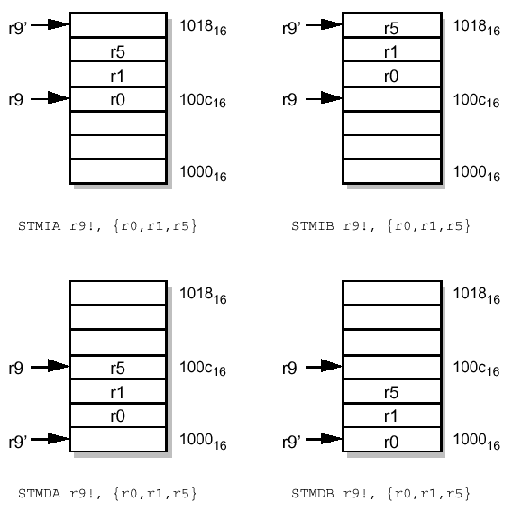
The four variants of the STM instruction
high
r9 SP value before
r9’ SP value after
LDM will undo what STM does
STM followed by LDM leaves registers and memory unchanged
low
STMEA R9!, {R0,R1,R5}
STMFA R9!, {R0,R1,R5}
high
Higher register numbers stored or loaded to/from higher addresses, always
low
STMED R9!, {R0,R1,R5}
STMFD R9!, {R0,R1,R5}

Slide 81
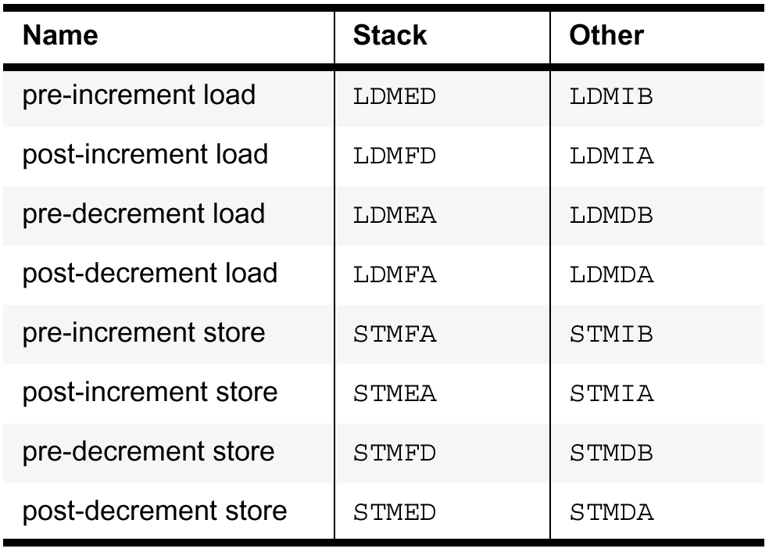
Alternative names for LDM/STM instructions!
Not used by ARM

Slide 82
Subroutines
Subroutines allow you to modularize your code so that they are more reusable.
The general structure of a subroutine in a program is:
MAIN
......
BL SUB1 ;subroutine call
......
SUB1
.....
MOV PC,R14
main program
subroutine

Slide 83
Branch & Link instruction
BL SUBR_NAME (Branch-and-Link) is the instruction to jump to subroutine. It performs the following operations:
1) It saves the address of the next instruction in R14. This is the return address.
2) It loads PC with the address of the subroutine (label SUBR_NAME). This performs a branch.
BL always uses R14 to store the return address. R14 is called the link register (can be referred to as either LR or R14 in assembly code).
Return from subroutine is simple: - just MOV R14 back into PC (R15).
This is called a computed branch (because the branch target is variable)
Notes:
BL is very similar to B
Only difference is that return address (address of instruction after current) is stored in a register R14
R14 is fixed for this purpose and is also called link register

Slide 84
Example
Essential documentation for subroutines must describe
Inputs: list of registers
Outputs (if any): list of registers, what each output is
What subroutine does (other than compute outputs)
Which registers it changes (other than the outputs)
EXAMPLE: Subroutine to move n bytes (spaced one per word) into n contiguous bytes at a different position in memory
0x1000
0x1004
0x1008
0x3000
0x3003
0x3002
0x3001
0x3000
Notes:
Subroutines typically perform operations that are reused several times in a program
Inputs are normally held in registers
Outputs are in registers
Subroutine may have some effect on memory, as here.

Slide 85
PACK_BYTES
; Input:
; src = R0 : pointer to first source (byte) address
; dest = R1 : pointer to first destination (byte) address
; n = R2 : number of bytes to transfer
; Transfers LSB bytes of words [R0],[R0+4], ..., [R0+4(n-1)]
; into a contiguous range of bytes [R1],[R1+1],.....[R1+n-1]
; Changes R2,R3
LOOP SUBS R2, R2,#1 ; n := n-1
LDRB R3, [R0,R2, lsl #2] ; load first byte [R0+4(n-1)]
STRB R3, [R1,R2] ; store it [R1+n-1]
BNE LOOP ; loop if not finished (Z from SUBS)
MOV PC, R14 ; return to caller
MAIN ADR R0, TAB1 ; set up subroutine inputs
ADR R1, TAB2
MOV R2, #100
BL PACK_BYTES ; call the subroutine
; instruction here executed after subroutine return
Notes:
R0 and R1 determine the two memory areas which bytes are copied from and too
R0 must be a LSB within a word – hence the byte address is also a word address
Each iteration of the loop moves 4 bytes through src area (R0), and 1 byte through dest area (R1)
In the code here MAIN is the user code which called subroutine PACK_BYTES.
Note, unusually, that no initialisation is needed so LOOP = PACK_BYTES (LOOP label could be omitted with branch back to PACK_BYTES)

Slide 86
Nested Subroutines
Active
SUB1
BL SUB2
Active
Executing
SUB2
BL SUB3
SUB3
X
Return address3
Return address2
Return address1
When executing at "X" the subroutines SUB1, SUB2, SUB3 are all active
This is nesting of subroutines
It requires special care to preserve multiple return addresses
Notes:
At point X return addresses back to SUB2 and SUB1 are stored. Also (not shown here) return address from SUB1 back to main code.

Slide 87
Nested Subroutines
Since the return address is held in register R14, you should not call a further subroutine without first saving R14.
How do you achieve this goal?
Could use separate memory storage for each subroutine
Problem: storage needed scales with number of subroutines.
Typically may have 1000s of subroutines, means 1000s of separate storage locations
The number of subroutines active at any time (nested) is much smaller than the total number (typically 10,000), and typically less than 10.
This motivates use of a stack – an area of memory which is shared and stores only the temporary data needed by nested subroutines active but not currently executing.
We can save the old value of all registers changed by a subroutine on stack, not just R14.
Just before the subroutine returns we restore the value of these registers to that used by the calling subroutine.
SUB1
store 1
SUB2
store 2
SUB3
store 3

Slide 88
The idea of a STACK
A stack is a portion of main memory used to store data temporarily, so that the memory can be shared between different items at different times.
A PUSH operation saves a number of registers onto the stack memory.
R13 is called the stack pointer SP
Notes:
Any subroutine can make use of the next available storage by using a PUSH

Slide 89
Nested Subroutines using stack
Stack
Memory
SUB1
BL SUB2
SUB1
data
high
SUB2
BL SUB3
SUB3
X
BL SUB4
downwards
growing
stack
SUB2
data
SUB3
data
Stack pointer at X
empty
Here each subroutine pushes the registers it needs to preserve onto the stack on entry
When executing "X" the nested subroutines SUB1, SUB2, SUB3 are all active, the data pushed by each is preserved on the stack
We have seen that typically LR will be pushed
low
Notes:
This shows how nested subroutines use consecutive locations in a stack.
Unlike normal memory access the exact address of the stored data depends on how many subroutines are nested and is not fixed
Data to be pushed is anything that needs to be – typically the LR that gets over-written by a nested return address

Slide 90
Implementing PUSH using STR
mem32[R13] := R14 ; transfer the data
R13 := R13-4 ; grow stack downwards
STR R14, [R13], #-4
Would need one post-indexed immediate offset STR instruction for each item stored...
R13
R13
0x1344
high
high
0x1340
stored item
0x134C
stored item
0x134C
stored item
0x1348
stored item
0x1348
PUSH
0x1344
stored R14
0x1344
0x1340
0x1340
low
low
Notes:
PUSH could be implemented with STR as here.
Post-increment addressing changes the stack pointer R13 after the data is stored to memory

Slide 91
PUSHing onto a Stack: multiple registers
Note the following properties of this ARM PUSH operation:
R13 is used as the address of the next empty location on the stack. We call this the STACK POINTER (SP). We could have used any other registers (except R15) as SP, but it is good practice to use R13 unless there is a good reason not to do so.
This stack grows down through decreasing memory address, and
The SP points to the first empty location of the stack. To store values in memory, the SP is decremented after it is used.
ARM has a single instruction which transfers multiple registers to a stack and implements PUSH this way:
STMED R13!, {R1, R3-R5, R14} ; Push R1, R3, R4, R5, R14 onto stack
; Stack grows down in memory
; R13 points to next empty loc.
Notes:
Normally more than one registers must be PUSHed. ARM has special instruction for multiple reg PUSH
The stack defined by this PUSH (STMED) is empty descending – memory addresses get lower as data is PUSHED

Slide 92
STMED vs STR
These two instructions have the same effect
STMED can be used with any number of registers. In this case it is more efficient
STMED is conventionally used for stacks even when only a single transfer is needed
stack pointer first, then list of one or more data registers, offset is calculated and added after operation
STMED R13!, {R14}
data register first, then stack pointer, offset is explicitly written and added to SP after operation
STR R14, [R13], #-4
Notes:
Note the very different syntax for STMED and STR

Slide 93
POP operation
The complementary operation to PUSH is POP
POP in this case must increment SP first, and then load the location pointed to by SP (pre-indexed addressing) once for each location POPed.
This is equivalent to the ARM instruction:
LDMED R13!, {R1, R3-R5, R14} ; Pop R1, R3-R5, R14 from stack
Notes:
We could implement POP using an LDR
But LDMED will POP multiple registers and is normally used.
POP is the reverse of PUSH. Notice that the SP must be incremented before each memory operation (pre-increment)

Slide 94
Multiple Stack Operations: order of data
A stack operates as a Last In First Out memory:
PUSH A A stored
PUSH B B, A stored
PUSH C C,B,A stored
POP (returns C) B,A stored
POP (returns B) A stored
POP (returns A) empty
Nested subroutines will each PUSH and then POP their registers at the same level (all PUSHes & POPs from subroutine calls will balance) so this will work.
Notes:
As long as PUSH and POP balances in each subroutine, the data PUSHED at the start of a subroutine is recovered by a POP at the end of a routine.

Slide 95
Preserve things inside subroutine with push/pop
BL SUB1
…..
SUB1 STMED R13!, {R0-R2, R14} ; push work & link registers
….
BL SUB2 ; jump to a nested subroutine
…
LDMED R13!, {R0-R2, R14} ; pop work & link registers
MOV PC, R14 ; return to calling program
Notes:
Here is a template for how to use LDMED and STMED in a subroutine
Also, at the end of subroutine SUB1, the MOV instruction returns to the return address set by the BL SUB1 instruction
Note how range of registers R0-R2 ~ R0,R1,R2 can be represented as well as individual register R14

Slide 96
; Input: R0
; Output: R1=1 if odd parity of R0 (xor of all 32 bits), otherwise 0
; preserves value of R2 on stack
STMED R13!, {R2} ; save registers, why not R1 or R14?
MOV R2, #31
MOV R1, #0
LOOP EOR R1, R0, R1, ROR #1
SUBS R2, R2, #1
BPL LOOP ; loop 32 times
; at this point each bit of R1 is the EOR of all 32 bits in R0
; therefore R1 = 0 or R1 = 0xFFFF,FFFF
AND R1, R1, #1 ; now R1 = 1 or 0
LDMED R13!, {R2} ;restore registers
MOV PC, R14 ; return to caller
Notes:
R1 is an output so will be overwritten – previous value need not be stored
R14 is never overwritten here because there is no BL so it can be kept in a register and not stored.

Slide 97
Optimising subroutine entry/exit
The usual case is for a subroutine which calls other subroutines, and so which saves and restores registers including R14, the return address.
In this case the subroutine exit can be optimised by restoring R14 directly to the PC: (R15).
Note that it is important NOT to include both R14 & R15 in the LDMED register list - which would be one too many POPs!
STMED R13!, {R0,R1,R2,R14}
…….
LDMED R13!,{R0,R1,R2, R14}
MOV PC, R14 ; return to caller
STMED R13!, {R0,R1,R2,R14}
…….
LDMED R13!,{R0,R1,R2,PC} ; return to caller
Notes:
This slide shows an optimisation that can be made to the subroutine return if R14 needs to be stored because of a BL inside the subroutine
This is the first example we have seen of pushing from one register and popping back to a different one.

Slide 98
Effect on stack of subroutine nesting
SUBX STMED R13!, {R14}
BL SUBY
.......
LDMED R13!, {PC}
SUBY STMED R13!, {R4,R5,R6}
.....
LDMED R13!,{R4,R5,R5}
MOV PC, R14
SUBX (1) calls SUBY(2)
The arrangement of storage on the stack when inside SUBY is as follows
SUBX caller return adddress
Stack (downwards growing)
Base of stack is highest location
high
Rest of stack
Stack pointer before SUBX
R14
Stack frame (1) SUBX
Stack pointer inside SUBX
R6
R5
Stack frame (2) SUBY
R4
Stack pointer inside SUBY
low
Top of stack is SP+4 (lowest location)
Notes:
Here SUBX calls SUBY. The SUBY stack frame is stored immediately beliw SUBX stack frame on the (descending) stack.

Slide 99
Other uses of LDM/STM
LDM,STM can work with any register being SP, not just R13
Can move block of memory by setting up SP1, SP2, POP from SP1, PUSH to SP2
Faster than LDR/STR
The 4 types of stack POP & PUSH have different mnemonics (for convenience) when used for general data movement like this.
It does not matter which mnemonic you use: LDMED & LDMIB from the reference slide are the same instruction
Notes:
These instructions are general move multiple resisters to/from memory
Faster for block memory transfer than LDR/STR
Assembler has alternate mnemonics for the same instruction which indicate this different use

Slide 100
Example of using Load/Store Multiple
Here is an example to move 8 words from a source memory location to a destination memory location:-
Note the omitted ! which, as with LDR,STR, means that R0,R1 are not changed
In fact, one could use 4 different form of load/store:
Increment - After LDMIA and STMIA
Increment - Before LDMIB and STMIB
Decrement - After LDMDA and STMDA
Decrement - Before LDMDB and STMDB
ADR R0, src_addr ; initialize src addr
ADR R1, dest_addr ; initialize dest addr
LDMIA R0, {R2-R9} ; fetch 8 words from mem
; … [R0 := R0+32 if !]
STMIA R1, {R2-R9} ; copy 8 words to mem, [R1 := R1+32 if !]
(see next slide)
Notes:
Increment After – increment base register after each register/memory transfer
Base register is first operand (is stack pointer in case of a stack)
The two instructions here DO NOT CHANGE base register because no !. Note that when used for stack the base register must always be changed.
The two forms of the instriuction can both be used with or without base register update – but it makes no sense to use the stack form without update.

Slide 101
Optional update of base address register with Load/Store Multiple Instructions
You can choose NOT update the SP register removing the "!", as in slide 2.102. All variants of LDM/STM have optional SP update.
Note that the stored or loaded data, if multiple registers goes to/comes from different memory locations even though SP is unchanged by the instruction
LDMIA R1, {R2-R9} ; R2 := mem₃₂[R1]
; …………….
; R9 := mem₃₂[R1+28]
LDMIA R1!, {R2-R9} ; R2 := mem32[R1]
; …………….
; R9 := mem32[R1+28]
;R1 := R1 + 32 (8 registers)
"!" indicates R1 is changed
Notes:
This shows the difference between the two forms of the instruction
Note that the update is 4* number of registers added or subtracted

Slide 102
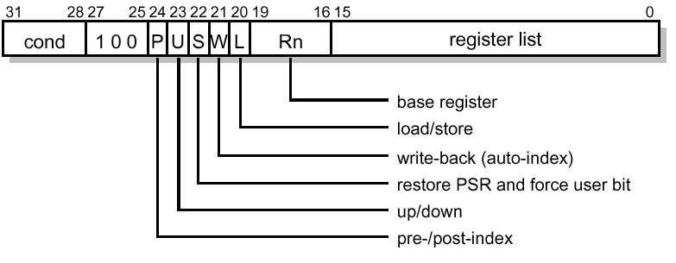
Machine code for multiple register transfer instructions
Register list field has one bit per register
bit 0 = 1 => load/store R0; bit 1 = 1 => load/store R1; etc
STMIA R13!, {R0-R2, R14} E8AD 4007
Notes:
Write-back bit controls base register update

Slide 103
Miscellaneous Issues
ARM past and present
Multiplication
Overview of machine instructions
Machine instruction timing

Slide 104
ARM Multiply instructions
The original ARM1 architecture did not have multiply instructions
32X32->32 bit (least significant 32 bits of result kept) was added for ARM3 and above
32X32->64 multiplication was added for ARM7DM and above.
The multiplications were “shoe-horned” into the data processing instructions, using bit combinations specifying shifts that were previously unused and illegal.

Slide 105
Multiply in detail
MUL,MLA were the original (32 bit LSW result) instructions
Why does it not matter whether they are signed or unsigned?
Later architectures added 64 bit results
Register operands only
No constants, no shifts
NB d & m must be different for MUL, MLA
ARM3 and above
MUL Rd, Rm, Rs multiply (32 bit) Rd := (Rm*Rs)[31:0]
MLA Rd,Rm,Rs,Rn multiply-acc (32 bit) Rd:= (Rm*Rs)[31:0] + Rn
UMULL Rl, Rh, Rm, Rs unsigned multiply (Rh:Rl) := Rm*Rs
UMLAL Rl, Rh, Rm, Rs unsigned multiply-acc (Rh:Rl) := (Rh:Rl)+Rm*Rs
SMULL Rl,Rh,Rm,Rs signed multiply (Rh:Rl) := Rm*Rs
SMLAL Rl,Rh,Rm,Rs signed multiply-acc (Rh:Rl) :=(Rh:Rl)+Rm*Rs
ARM7DM core and above (64 bit multiply result)

Slide 106
Example of using ARM Multiplier
This calculates a 64 bit scalar product of two signed vectors, each 20 words long:
R8 and R9 point to the two vectors x_{j} and y_{j}
R11 is the loop counter
R7:R6 stores the result
MOV R11, #20 ; initialize loop counter
MOV R7, #0 ; initialize 32 bit total
MOV R6, #0
LOOP LDR R0, [R8], #4 ; get x component
LDR R1, [R9], #4 ; …. and y component
SMLAL R6, R7, R0, R1 ; accumulate product
SUBS R11, R11, #1 ; decrement loop counter
BNE LOOP ; loop 20 times

Slide 107
ARM Machine Instruction Overview (1)
Data processing (ADD,SUB,CMP,MOV)
cond
0
0
0
Op
Rn
Rd
Shift
Rm
Rd := Rn Op Rm*
1
S
Rd := Rn Op S
ALU operation
Rm* = Rm with optional shift
multiply instructions are special case
Data transfer (to or from memory LDR,STR)
cond
0
1
0
Trans
Rn
Rd
S
Rd ↔ mem[Rn+S]
1
Shift
Rm
Rd ↔ mem[Rn+Rm*]
Byte/word, load/store, etc
Multiple register transfer
Transfer registers to/from stack
cond
1
0
0
Type
Rn
Register list

Slide 108
Overview (2)
Branch B, BL, BNE, BMI…
cond
1
0
1
L
S
PC := PC+S*4
0
L = 0 => Branch, B ...
1
L = 1 => Branch and link (R14 := PC), BL ...
cond
1
1
0
0
coprocessor interface
cond
1
1
0
1
cond
1
1
1
0
Software Interrupt (SWI)
Simulate hardware interrupt: S is passed to handler
cond
1
1
1
1
S
Notes:
Note difference from printed notes:
The branch offset constant is multiplied by 4, allowing a +/- 32GB branch range.

Slide 109
Part 2 Summary
Subroutines
ARM BL and subroutine return
Stacks: stack frames
Load/store multiple
To implement stacks
To implement block move
Miscellaneous ARM ISA topics: multiply instructions, instruction overview.
Data Processing and Shifts
Data Transfer
Subroutines

